Slide 1


Slide 2
Database Management Systems
Week 1, Day 4
MySQL—A RDBMS
Atta Muhammad
+92-333-1971110
attapanhyar@quest.edu.pk

Slide 3

RECAP
SELECT
DISTINCT
WHERE
BETWEEN
IN

Slide 4
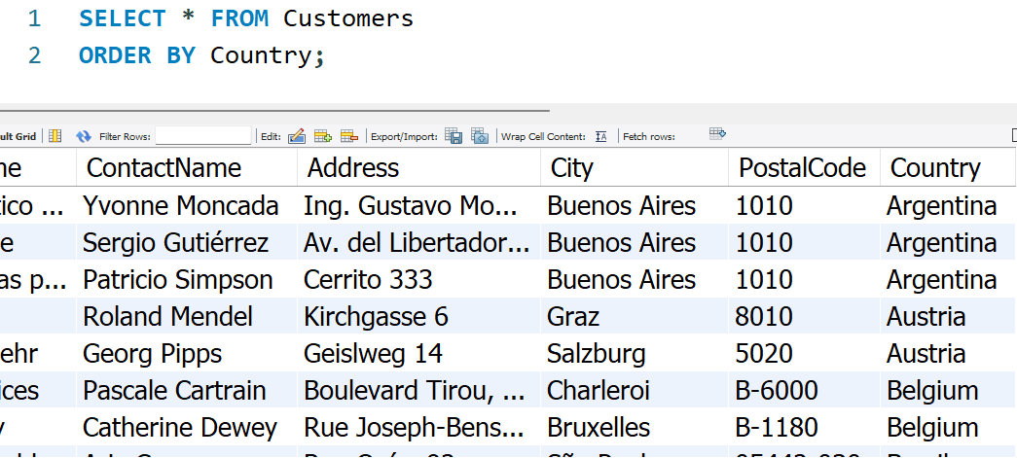
ORDER BY
The ORDER BY keyword is used to sort the result-set in ascending or descending order.

Slide 5
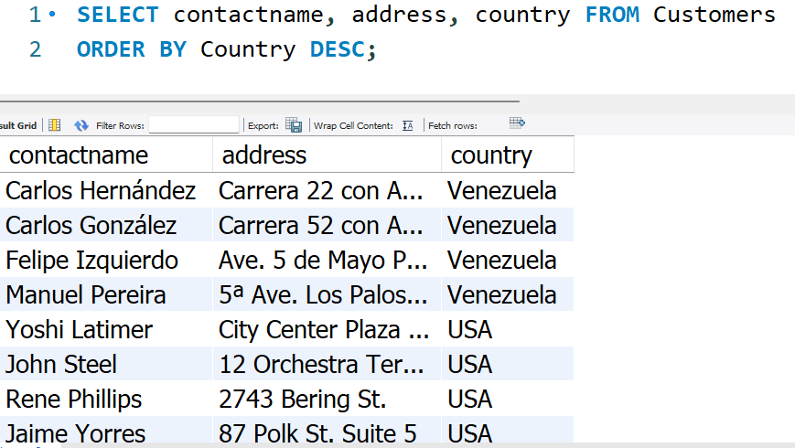
ORDER BY (ASC/DESC)

Slide 6
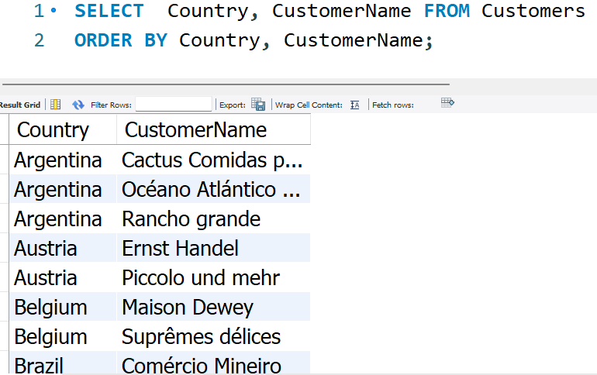
For several columns

Slide 7
INSERT INTO Statement
The INSERT INTO statement is used to insert new records in a table.

Slide 8
keep in Mind 😶‍🌫️
If you are adding values for all the columns of the table, you do not need to specify the column names in the SQL query.
However, make sure the order of the values is in the same order as the columns in the table

Slide 9
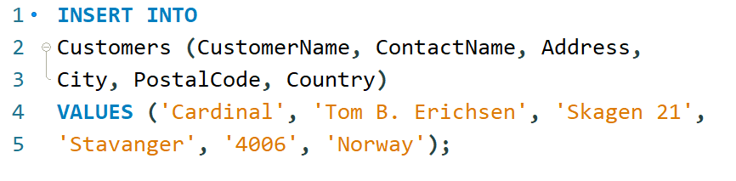
INERT INTO

Slide 10

INSERT INTO

Slide 11
NULL Values
We will have to use the IS NULL and IS NOT NULL operators instead

Slide 12
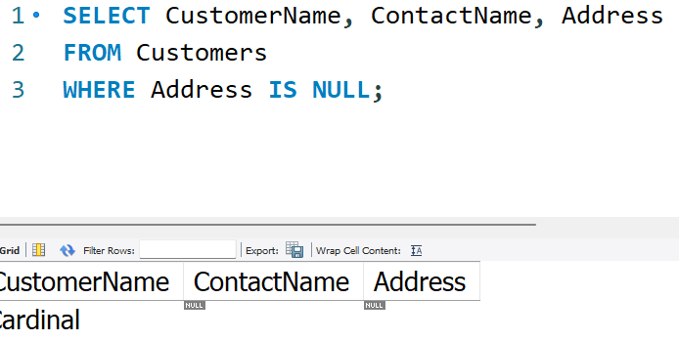
IS NULL

Slide 13
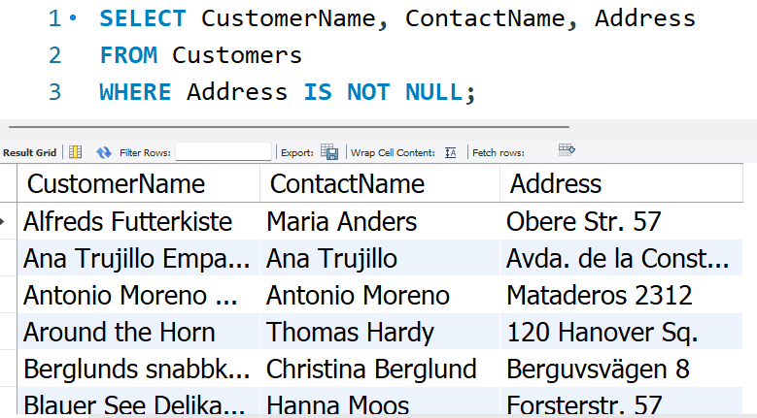
IS NOT NULL

Slide 14
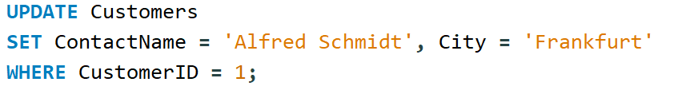
UPDATE Statement
The UPDATE statement is used to modify the existing records in a table.

Slide 15
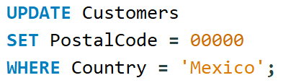
UPDATE Multiple Records

Slide 16
Beware!! If you forget to include WHERE clause all record in the table would be update.

Slide 17
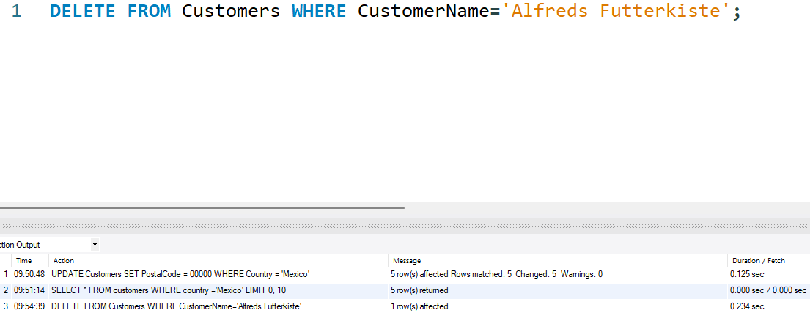
DELETE Statment
The DELETE statement is used to delete existing records in a table

Slide 18
LIMIT Clause
The LIMIT clause is used to specify the number of records to return.
The LIMIT clause is useful on large tables with thousands of records.
Returning many records can impact performance.

Slide 19
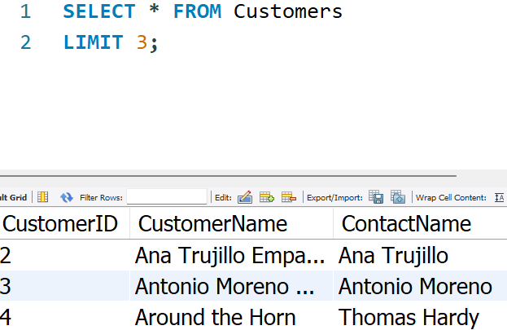

LIMIT EXAMPLE

Slide 20
MIN(), MAX() Functions
The MIN() function returns the smallest value of the selected column.
The MAX() function returns the largest value of the selected column.

Slide 21



Example

Slide 22
COUNT(), AVG() and SUM()
The COUNT() function returns the number of rows that matches a specified criterion.
The AVG() function returns the average value of a numeric column.
The SUM() function returns the total sum of a numeric column.

Slide 23

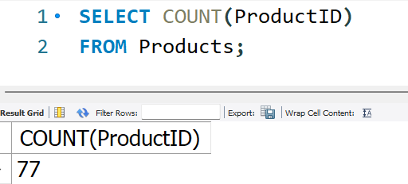
Count() Function

Slide 24
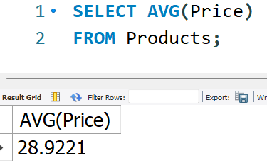

AVG() Function

Slide 25
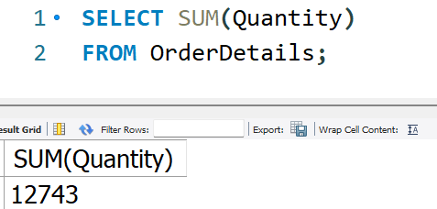

SUM() Function

Slide 26
Question

